Slide 1
Initial Process
Viswanathan Hariharan

Slide 2
Contents
Case study
Why is software organization chaotic?
Problems of scale

Slide 3
Case study
Let us look at the case of a large military software development contract
Watts Humphrey once participated in a review of this contract
He concluded that the project would be completed reasonably on time
He also observed that there was a small additional function to be developed and learnt from the team that it was not a problem
However no plan was made for developing the additional function

Slide 4
Case study…
After a few months when Watts Humphrey checked on the status of this project, he found out that the small additional function turned out to be 250,000 lines of code
Without a plan it was difficult to know how big the job was and where it stood
The project was ultimately completed, but the customer lost confidence in the software team and refused to pay for the additional work

Slide 5
Why are software organizations chaotic?
There are many unknowns in software development
  Requirements change
  Estimation is inaccurate
  # of defects is uncertain
As programs become larger, new issues come up
  Technical issues such as architectural challenges, integration issues, etc.
  Management issues such as coordination between teams, dependency between modules, optimal resource utilization
  Imagine a system consisting of new development, integration with many external systems and products, 15-20 sub-systems, 100+ people. No wonder things are extremely complicated and challenging to manage

Slide 6
Why are software organizations chaotic?
Increased competition & new management put pressure on software managers
  Under pressure software managers often make a guess of the time to incorporate a change request (which is many times non-trivial) and make commitments without sufficiently analysing the requirements and planning for it
  This invariably leads to insufficient time and resources
This increases the entropy (disorganization) of the project
  As projects get delayed and start impacting the business, the project gets escalated
  More time is spent in status reviews with top management and valuable PM time, needed to manage a troubled project, is further decreased
  More people are added to complete the project. This further increases the entropy of the team, more time is needed to bring the new members up to speed. This takes away valuable time of existing team members

Slide 7
Problems of scale
Human psychology:
  Having learnt to build small programs, we think we can build large ones, easily
The problems of scale are:
  Large software products are difficult to understand by one person – 30-40 sub-systems, 100+ modules, 6-8 external products to be integrated
  Greater coordination is needed between teams to design the software to define the responsibilities of each sub-system / module and the interfaces to be supported by each of them
  As software size increases, prototypes may have to be built to get a clearer understanding of requirements – for users as well as developers
  Several releases may be needed to complete the software development, which requires planning and executing each release
  User priorities need to be understood for each release, requiring coordination with end users and their management

Slide 8
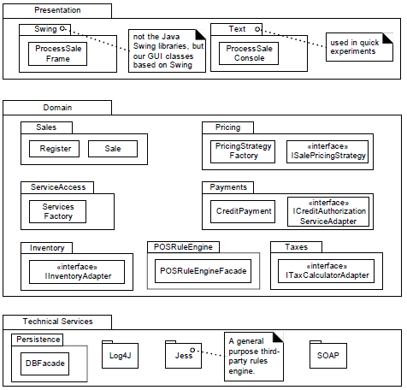
Example of objects in a software system
Taken from a book by Craig Larman

Slide 9
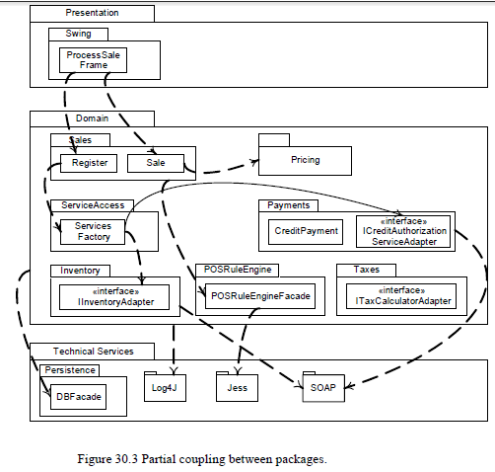
Example of inter-dependency between objects in a software system
Taken from a book by Craig Larman

Slide 10
Problems of scale…
Large software needs prototype and multiple releases
  Some requirements are clear only after some operational experience
    We have experienced how the features & User interface of Microsoft Word has undergone change, how the Railway booking (IRCTC) system has evolved, etc.
    Tata Nano car went through several rounds of prototype before finalizing the design – Engine was designed 3 times, Body design went through hundreds of iterations, etc.
    Very few IT organizations invest sufficiently in building prototypes of new product ideas. They are in a hurry to launch
  Requirements must be divided into different phases
    First phase will contain the most critical functions, Second phase will contain slightly less critical and so on…

Slide 11
Problems of scale…
Large software needs prototype and multiple releases
  Each component design must synchronize with needs of each phase
  Product inter-dependencies must be orchestrated
    If we want to implement a security feature in a module, this may impact other modules and also call for changes to the Database definitions to classify data into confidential data and regular data
  Integration plan needs to be scheduled around these inter-dependencies
So the software development process that works for a small software will not scale up for a large software product

Slide 12
Problem of scale – The way out
Systematic project management
  Estimate the effort for different parts & different activities of the software
  Plan the activities, resources & timelines
  Monitor the progress & take corrective measures when the project deviates from the plan
Careful change management
  Do not allow uncontrolled changes to requirement
Independent Quality assurance
  Arrange for an independent team to review the quality of work products at each stage and also review adherence to the development process
Partitioning software into independent parts
  Like how an ERP software is partitioned into module such as Marketing, Product Design, Production, Purchase, Quality, Human Resources, Finance, etc.
  They have well defined interfaces

Slide 13
Homework
Have you come across a situation where a significant requirement change was requested, late in the development cycle?
  If yes, can you describe how this was handled?
Have you worked in a large project?
  If yes, what were some of the key lessons learnt in managing a large project?

Slide 14
Appendix

